Slide 1
Department of Computer Science and Engineering (CSE)
INSTITUTE : UIE
DEPARTMENT : CSE
Bachelor of Engineering (Computer Science & Engineering)
Programming in Python Lab
(23CSP-201)
DISCOVER . LEARN . EMPOWER

Slide 2
Unit 2 Content
Department of Computer Science and Engineering (CSE)
UNIT-2 | Operations on Strings, list, Tuples, Sets & Dictionaries
Experiment 2.1 | String operations and methods (indexing, slicing, len(), strip(), find(), replace(), split(), join(), etc.).
Experiment 2.2 | List creation, accessing, and operations (append (), insert(), extend(), remove(), pop(), sort(), etc.).
Experiment 2.3 | Tuple creation, accessing, and operations: Demonstrate various methods of creating tuples, accessing tuple elements through indexing and slicing, and applying tuple methods/functions.
Experiment 2.4 | Sets and Dictionaries creation, accessing, and operations.

Slide 3
Department of Computer Science and Engineering (CSE)
Course Outcome
CO1 | Describe the basic fundamentals of python programming.
CO2 | Apply the python programming for Arithmetic, Logical and sorting operations.
CO3 | Analyze python programming loops & methods for data manipulation.
CO4 | Use the Python programming language for various programming techniques like list, tuples, dictionaries etc.
CO5 | Develop application software using object-oriented programming techniques in the Python language.
Will be covered in this lecture

Slide 4
OBJECTIVES
Department of Computer Science and Engineering (CSE)
At the completion of this Chapter, students should be able to do the following:
1. Proficiently manipulate strings, lists, tuples, sets, and dictionaries in Python, demonstrating a clear understanding of their unique properties and methods.
2. Apply appropriate data structures (strings, lists, tuples, sets, or dictionaries) to solve various programming problems, showcasing the ability to choose the most suitable structure for different scenarios.
3. Implement and debug code using these data structures, utilizing their respective methods and operations effectively to create efficient and readable Python programs.

Slide 5
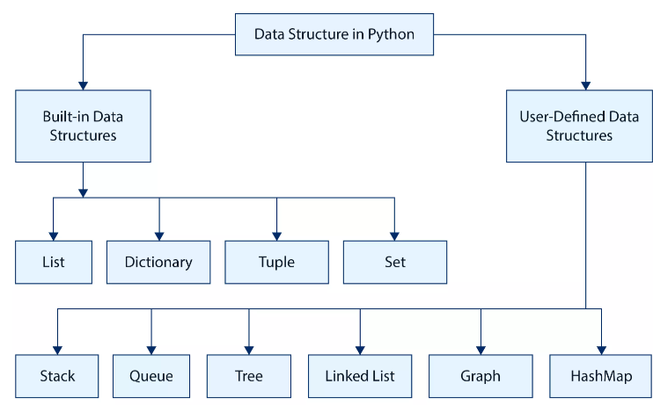
Python Data Structures
In Python, data structures are used to organize and store data efficiently. Python provides a variety of built-in data structures, each with its own characteristics and use cases.

Slide 6
Python Data Structures
List: List is an ordered collection of elements enclosed within [].
A list can store a collection of data of any size.
A list is a sequence defined by the list class.
It contains the methods for creating, manipulating, and processing lists.
There are addresses assigned to every element of the list, which is called as Index.
Elements in a list can be accessed through an index.
Lists are mutable.
The elements in a list are separated by commas.
A list can contain the elements of the same type or mixed types.

Slide 7
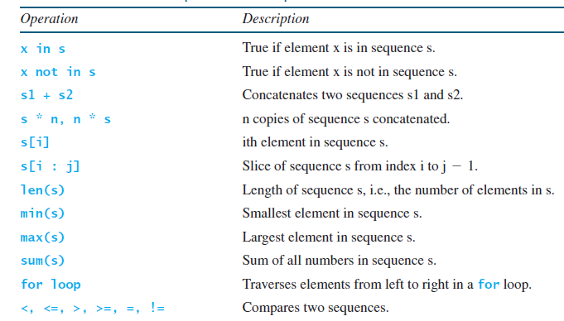
Python Data Structures
List Is a Sequence Type: A sequence type in Python is a collection of objects ordered by position, where each element can be accessed using an index. Strings and lists are sequence types in Python. A string is a sequence of characters, while a list is a sequence of any elements.
Common Operations for Sequences

Slide 8
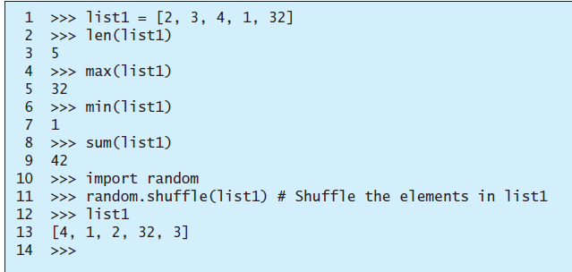
Python Data Structures
Functions for Lists: Several Python built-in functions can be used with lists.

Slide 9
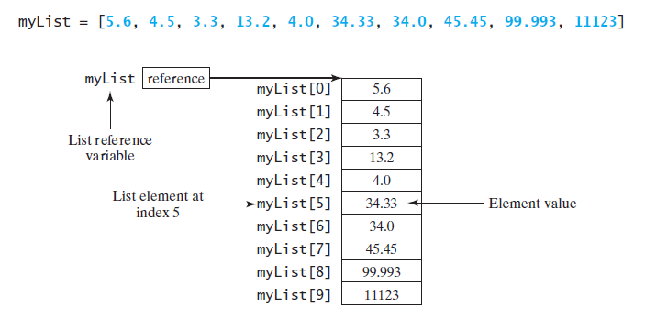
Python Data Structures
Index Operator []: An element in a list can be accessed through the index operator, using the following syntax:
myList[index]
List indexes are 0 based; that is, they range from 0 to len(myList)-1.
The list myList has 10 elements with indexes from 0 to 9.

Slide 10
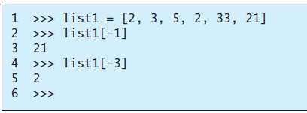
Python Data Structures
Python also allows the use of negative numbers as indexes to reference positions relative to the end of the list.
The actual position is obtained by adding the length of the list with the negative index. For example:

Slide 11
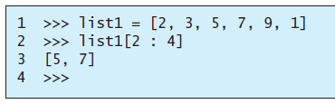
Python Data Structures
List Slicing [start : end]: The index operator allows you to select an element at the specified index. The slicing operator returns a slice of the list using the syntax list[start : end]. The slice is a sublist from index start to index end – 1. Here are some examples.

Slide 12
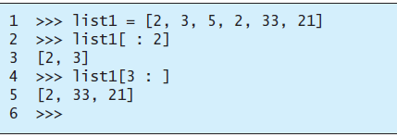
Python Data Structures
List Slicing [start : end]

Slide 13
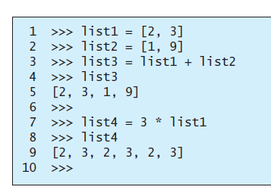


Python Data Structures
The +, *, and in/not in Operators:

Slide 14
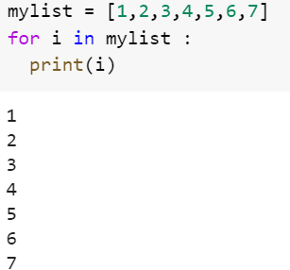
Python Data Structures
Traversing Elements in a for Loop: The elements in a Python list are iterable. Python supports a convenient for loop, which enables you to traverse the list sequentially without using an index variable. For example, the following code displays all the elements in the list myList:
for u in myList:
print(u)

Slide 15
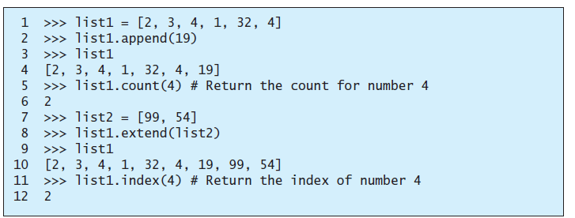
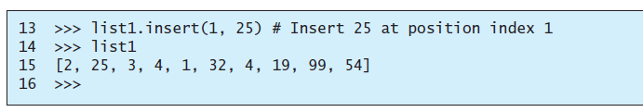
Python Data Structures
List Methods: append, count, extend, index, and insert methods

Slide 16
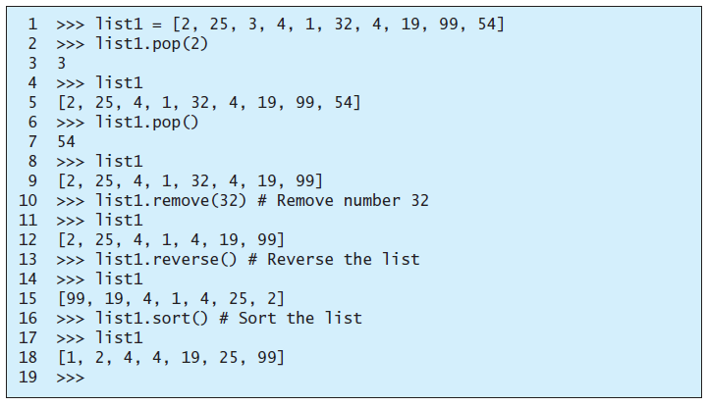
Python Data Structures
List Methods: insert, pop, remove, reverse, and sort methods

Slide 17
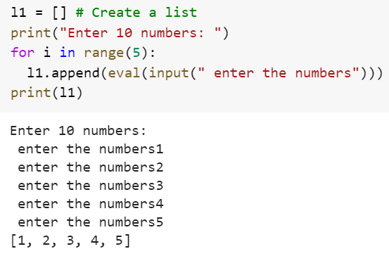
Python Data Structures
Inputting Lists

Slide 18
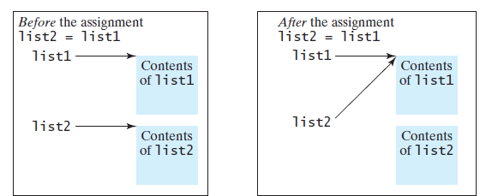
Python Data Structures
Copying Lists: To copy the data in one list to another list, you have to copy individual elements from the source list to the target list.
You often need to duplicate a list or part of a list in a program. In such cases you could attempt to use the assignment statement (=), as follows:
list2 = list1

Slide 19
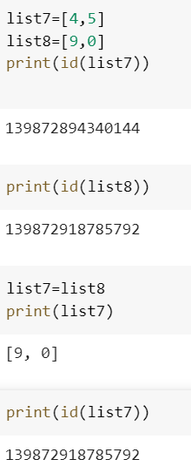
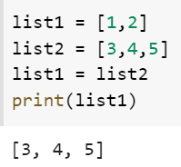
Python Data Structures
list2 = list1

Slide 20
Python Data Structures
Strings: Strings in python are surrounded by either single quotation marks, or double quotation marks.
'hello' is the same as "hello".
Strings are immutable, meaning they cannot be changed once created.
Characters of a String can be accessed by using the method of Indexing.
Indexing allows negative address references to access characters from the back of the String.
We can create a string using the constructor of the str class as:
s1=str() #creates an empty string
s2=str(“hello”) #creates a string object for hello

Slide 21
Python Data Structures
Python string methods is a collection of in-built Python functions that operates on lists.
These methods allow you to manipulate and perform various operations on strings, such as finding substrings, replacing characters, converting cases, and more.
Upper: string.upper() converts a string to uppercase.
Lower: string.lower() converts a string to lowercase.
Concatenation: str1 + str2 combines two strings.
Length: len(string) returns the length of a string.
Find: string.find(substring) locates the index of the first occurrence of a substring.

Slide 22
Python Data Structures
Count: string.count(substring) counts the occurrences of a substring in a string.
Replace: string.replace(old, new) replaces occurrences of a substring with another substring.
Strip: string.strip() removes leading and trailing whitespace.
StartsWith: string.startswith(prefix) checks if a string starts with a specified prefix.
EndsWith: string.endswith(suffix) checks if a string ends with a specified suffix.
Split: string.split(separator) splits a string into a list of substrings based on a separator.
Join: separator.join(list) joins a list of strings into a single string with a separator.

Slide 23
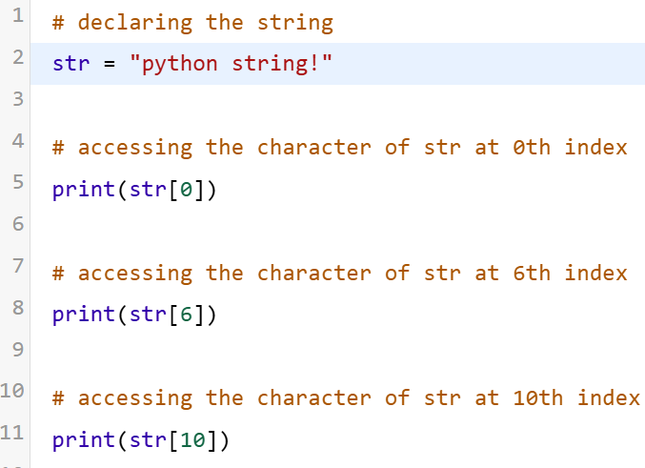
Python Data Structures
How To Index and Slice Strings in Python?
Indexing: Indexing means referring to an element of an iterable by its position within the iterable. Each of a string’s characters corresponds to an index number and each character can be accessed using its index number.

Slide 24
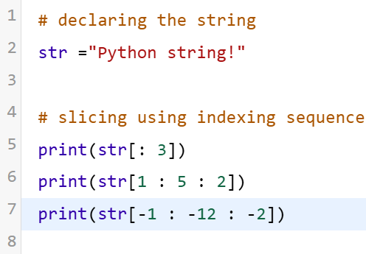
Python Data Structures
Slicing: Slicing in Python is a feature that enables accessing parts of the sequence. In slicing a string, we create a substring, which is essentially a string that exists within another string.

Slide 25
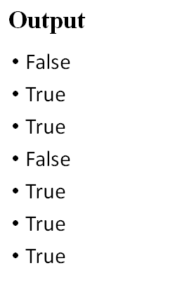
Python Data Structures
Testing strings:
String class in python has various inbuilt methods which allows to check for different types of strings.
s = "welcome to python"
print(s.isalnum())
print("Welcome".isalpha())
print("2012".isdigit())
print("first Number".isidentifier())
print(s.islower())
print("WELCOME".isupper())
print(" \t".isspace())

Slide 26
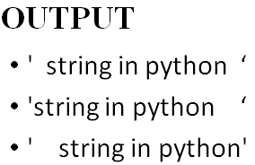
Python Data Structures
Formatting String :
s = “ string in python”
s1 = s.center(20) # place the string in the center with 20 char
print(s1)
s = “ string in python”
s1 = s.ljust(20) # place the string in the left with 20 char
print(s1)
s = “ string in python”
s1 = s.rjust(20) # place the string in the right with 20 char
print(s1)

Slide 27
Python Data Structures
Tuples : Tuples are like lists, but their elements are fixed; that is, once a tuple is created, cannot add new elements, delete elements, replace elements, or reorder the elements in the tuple. Tuple is immutable.
A tuple is very much like a list, except that its elements are fixed.
It is enclosed within ().

Slide 28
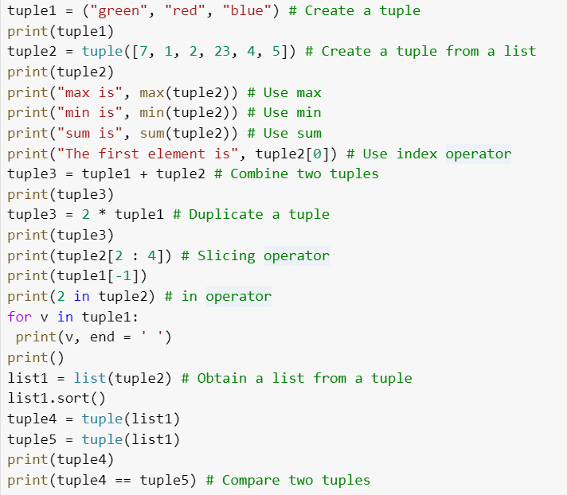
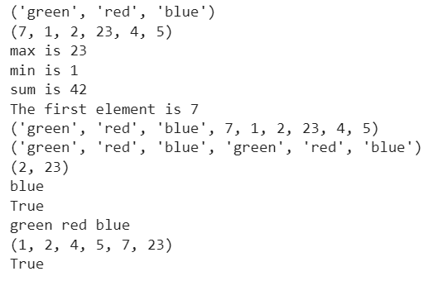
Python Data Structures

Slide 29
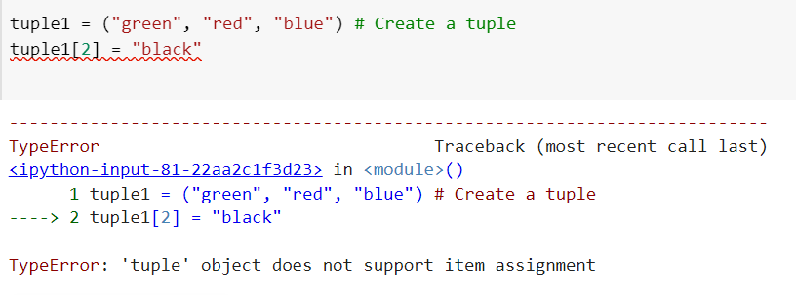
Python Data Structures
Cannot modify a tuple because it is immutable.

Slide 30
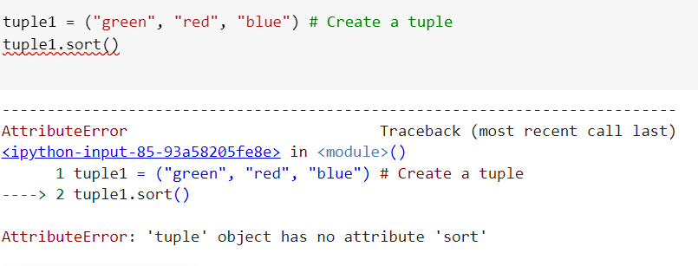
Python Data Structures
Cannot modify a tuple because it is immutable.

Slide 31
Python Data Structures
Sets : Sets are like lists storing a collection of elements.
Unlike lists, however, the elements in a set are nonduplicates and are not placed in any particular order.
It is enclosed within { }.
A set can contain the elements of the same type or mixed types.
For example, s ={1, 2, 3, "one", "two", "three"} is a set that contains numbers and strings.
Set items are unchangeable, but you can remove items and add new items.
Sets cannot have two items with the same value.

Slide 32
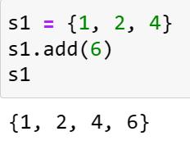
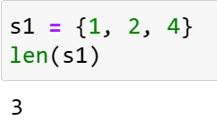
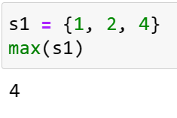
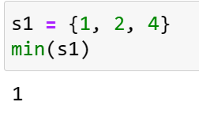
Python Data Structures
Manipulating and Accessing Sets: Add an element to a set or remove an element by using the add(e) or remove(e) method. You can use the len, min, max, and sum functions on a set, and a for loop to traverse all elements in a set.
Use in or not in operator to determine whether an element is in the set.

Slide 33
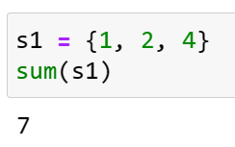
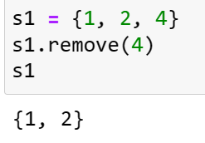
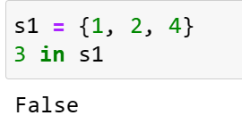
Python Data Structures
Manipulating and Accessing Sets
The remove(e) method will throw a KeyError exception if the element to be removed is not in the set.

Slide 34
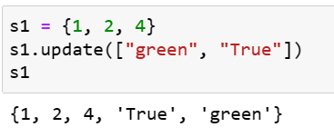
Python Data Structures
Manipulating and Accessing Sets

Slide 35
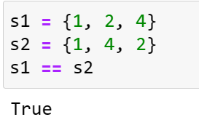
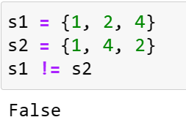
Python Data Structures
Equality Test: the == and != operators to test if two sets contain the same elements. For example:

Slide 36
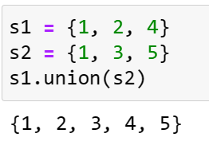
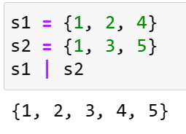
Python Data Structures
Set Operations: Python provides the methods for performing set union, intersection, difference, and symmetric difference operations.
The union of two sets is a set that contains all the elements from both sets.
Use the union method or the | operator to perform this operation. For example:

Slide 37
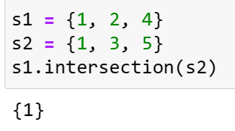
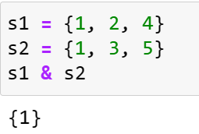
Python Data Structures
Set Operations: Python provides the methods for performing set union, intersection, difference, and symmetric difference operations.
The intersection of two sets is a set that contains the elements that appear in both sets. Use the intersection method or the & operator to perform this operation. For example:

Slide 38
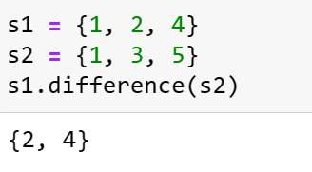
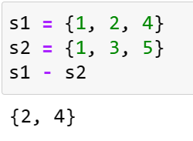
Python Data Structures
Set Operations: Python provides the methods for performing set union, intersection, difference, and symmetric difference operations.
The difference between set1 and set2 is a set that contains the elements in set1 but not in set2. Use the difference method or the - operator to perform this operation.
For example:

Slide 39
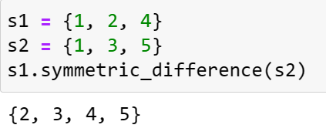
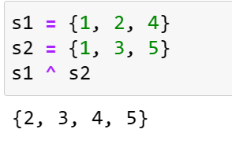
Python Data Structures
Set Operations: Python provides the methods for performing set union, intersection, difference, and symmetric difference operations.
The symmetric difference (or exclusive or) of two sets is a set that contains the elements in either set, but not in both sets. You can use the symmetric_difference method or the ^ operator to perform this operation. For example:

Slide 40
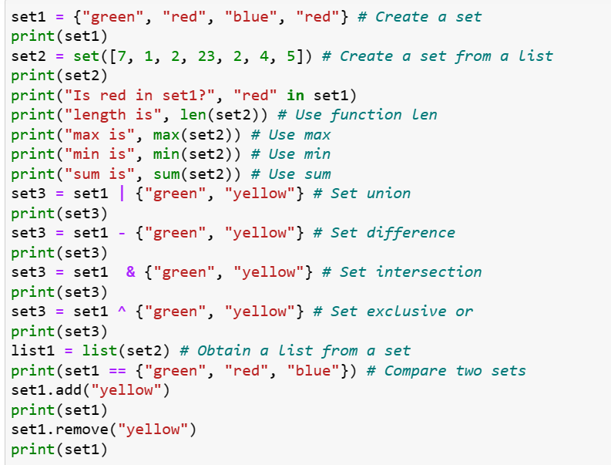
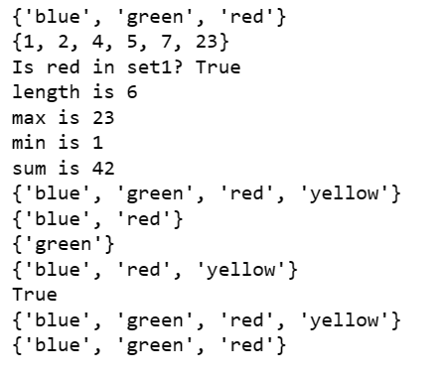
Python Data Structures

Slide 41
Python Data Structures
Dictionaries: A dictionary is a container object that stores a collection of key/value pairs.
It enables fast retrieval, deletion, and updating of the value by using the key.
A dictionary is an efficient data structure for such a task.
A dictionary is a collection that stores the values along with the keys. The keys are like an index operator.
A dictionary cannot contain duplicate keys. Each key maps to one value.
A key and its corresponding value form an item (or entry) stored in a dictionary.

Slide 42
Python Data Structures
Dictionaries: The data structure is a called a “dictionary” because it resembles a word dictionary, where the words are the keys and the words’ definitions are the values.
A dictionary is also known as a map, which maps each key to a value.
Dictionary is mutable.
Creating a Dictionary: Create a dictionary by enclosing the items inside a pair of curly braces ({}). Each item consists of a key, followed by a colon, followed by a value. The items are separated by commas.

Slide 43
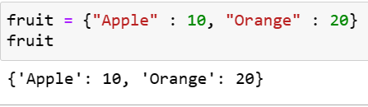
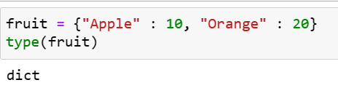
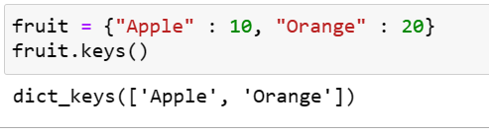
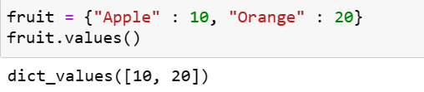
Python Data Structures

Slide 44
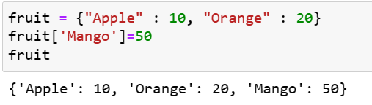
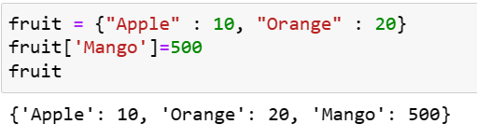


Python Data Structures
Adding a new element, changing an existing element, update, pop

Slide 45

Python Data Structures
Adding a new element, changing an existing element, update, pop, clear

Slide 46
Python Data Structures
Difference between list, tuple, set and dictionary
List | Tuple | Set | Dictionary
List is a non-homogeneous data structure that stores the elements in single row and multiple rows and columns | Tuple is also a non-homogeneous data structure that stores single row and multiple rows and columns | Set data structure is also non-homogeneous data structure but stores in single row | Dictionary is also a non-homogeneous data structure which stores key value pairs
List can be represented by [ ] | Tuple can be represented by ( ) | Set can be represented by { } | Dictionary can be represented by { }
List allows duplicate elements | Tuple allows duplicate elements | Set will not allow duplicate elements | Set will not allow duplicate elements and dictionary doesn’t allow duplicate keys.

Slide 47
Python Data Structures
Difference between list, tuple, set and dictionary
List | Tuple | Set | Dictionary
List can be created using list() function | Tuple can be created using tuple() function. | Set can be created using set() function | Dictionary can be created using dict() function.
List is mutable i.e we can make any changes in list. | Tuple is immutable i.e we can not make any changes in tuple | Set is mutable i.e we can make any changes in set. But elements are not duplicated. | Dictionary is mutable. But Keys are not duplicated.
Creating an empty list l=[] | Creating an empty Tuple t=() | Creating a set a=set() | Creating an empty dictionary d={}

Slide 48
Outcomes
Department of Computer Science and Engineering (CSE)
Apply Python's built-in data structures (strings, lists, tuples, sets, and dictionaries) to manipulate and organize data effectively.
Implement appropriate methods and operations for each data structure to solve practical programming problems.
Analyze and select the most suitable data structure for different programming scenarios, demonstrating understanding of their unique characteristics and performance implications.

Slide 49
Python Data Structures
SUGGESTED TEXTBOOKS
Ashok Namdev Kamthane, Programming and Problem Solving with Python, Mc Graw Hill Education Publication, 1st Edition, November 2017.
Kenneth Lambert, Fundamentals of Python :First Programs, Cengage Learning
Allen Downey, Think Python, O'Reilly Media, 2nd Edition,2015.
REFERENCE BOOKS
Rajaraman V,” Computer Oriented Numerical Methods”, Pearson Education.
Y. Daniel Liang, Introduction to Programming Using Python, Pearson.
Martin C.Brown, PYTHON The Complete REFERENCE, Tata McGraw-Hill
Education, 4th Edition, March 2018.

Slide 50



Department of Computer Science and Engineering (CSE)

